Slide 1
Portable Fire Extinguisher Training
Updated Fall, 2016

Slide 2
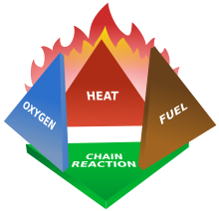
Fire Tetrahedron
Fire requires 4 things to support combustion:
Heat
Oxygen
Fuel
Chemical Reaction
Remove 1 element and the fire goes out

Slide 3
Class A Fires
Class A fires are in ordinary combustibles such as wood, paper, cloth, trash and plastics.

Slide 4
Class B Fires
Class B fires are fires in flammable liquids such as gasoline, petroleum oil and paint. Class B fires also include flammable gases such as propane and butane.
Cooking oils and grease are not included.

Slide 5
Class C Fires
Class C fires are fires involving energized electrical equipment such as motors, transformers and appliances.
Remove the power, and Class C fire becomes one of the other classes of fire.

Slide 6
Class D Fires
Class D fires are fires in combustible metals such as potassium, sodium, aluminum and magnesium.

Slide 7
Class K Fires
Class K fires are fires in cooking oils and greases such as animal fats and vegetable fats.

Slide 8
Types of Fire Extinguishers
Water and Foam fire extinguishers take away the heat element of the fire. Foam agents also separate the oxygen element from the other elements.
Water extinguishers are for Class A fires only – they should not be used on Class B or C fires. They could spread the flammable liquid or cause a shock hazard.

Slide 9
Types of Fire Extinguishers
Carbon Dioxide fire extinguishers take away the oxygen element of the fire and also remove the heat with a very cold discharge.
Carbon dioxide extinguishers can be used on Class B & C fires. They are likely to be ineffective on Class A fires.

Slide 10
Types of Fire Extinguishers
Dry Chemical fire extinguishers extinguish the fire by interrupting the chemical reaction of the fire. They also create a barrier between the oxygen and fuel elements on Class A fires.
This is most widely used type of fire extinguisher and is effective on Class A, B & C fires. This is the most common type of fire extinguisher on the SDSU campus.

Slide 11
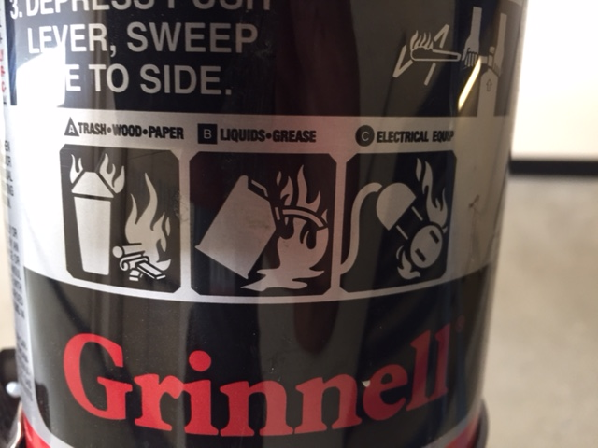
Pictographs
Most fire extinguishers will have a pictograph label telling you which types of fire the extinguisher is designed to fight.
Most extinguishers on campus are A-B-C extinguishers meaning they can be used on a wide range of fires.

Slide 12
Using a Fire Extinguisher
When it is time to use the extinguisher on a fire, just remember PASS!
Pull the pin.
Aim the nozzle or hose at the base of the fire from the recommended safe distance.
Squeeze the operating lever to discharge the fire extinguishing agent.
Sweep the nozzle or hose from side to side until the fire is out.

Slide 13
Rules for Fire Fighting
Just remember the three “A’s”
Activate the building alarm system or call 9-1-1.
Assist any persons in immediate danger or those needing assistance, if it can be done without risk to yourself.
Attempt to extinguish the fire only after completing the first two.

Slide 14
Report Use
Report the use of a fire extinguisher immediately (only need to contact one):
SDSU Emergency Services
619-594-7903
Environmental Health & Safety
619-594-
SDSU Police Department
619-94-1991

Slide 15
Questions?
Any further questions or for more information contact:
SDSU Emergency Services
Lamine Secka, Director of Emergency Services
lsecka@mail.sdsu.edu
619-594-7903

